Slide 1

Deep learnig for
event-driven stock prdiction
廖庆文
2017-10-26

Slide 2
01
Introduction
目录
02
Event-embedding
CONTNETS
03
Deep Prediction Model
04
Experiments

Slide 3
Introdution
Related work
some prediction techniques leverage historical and time-series data [Taylor and Xu, 1997]
mainly uses simple features from news documents, such as bags-of-words, noun phrases, and named entities[Cutler et al., 1998; Tetlock et al., 2008;]
for example： Representing the event “Microsoft sues Barnes & Noble.” using term-level features {“Microsoft”, “sues”, “Barnes”, “Noble”} alone
3. Using open information extraction (Open IE) to obtain structured events representations[Ding et al., 2014]
(Actor = Microsoft, Action = sues, Object = Barnes & Noble).
4. sentiment is another perspective of deep semantic analysis of news documents [Das and Chen, 2007; Tetlock, 2007; Tetlock et al., 2008; Bollen et al., 2011; Si et al., 2013]
Notes:
股票价格的波动受到新闻或者事件的影响，NLP挖掘这些文本的信息来进行股票价格的预测
1.不能捕获结构上的关系
2.使用结构化的描述来代替词语作为事件的特征，增加稀缺性

Slide 4
Introdution
Our work
We propose to address this issue by representing structured events using event embeddings, which are dense vectors. We train event embeddings using a novel neural tensor network (NTN)
we propose to use deep learning to capture the influence of news events over a history that is longer than a day.
we are the first to use a deep learning model for event-driven stock market prediction
Notes:
稠密的向量，即使事件没有相同的词，也能获得相似的向量
作者认为尽管long-term影响会减弱，股票市场价格的波动仍受影响，长中短结合起来，很少有人会这么做

Slide 5
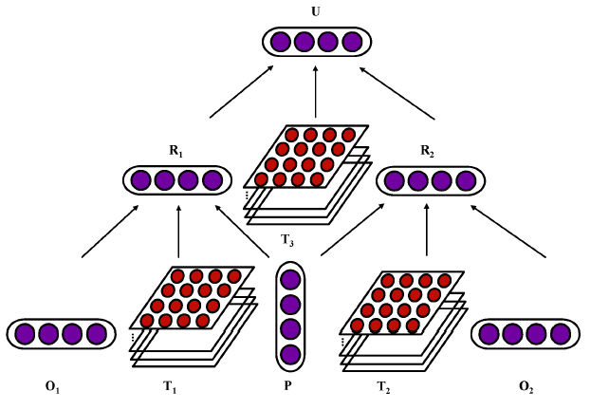

Neural Tensor Network for Learning Event Embeddings
(Actor = Google, Action = acquires, Object =
Nest, Time = Jan 13, 2014).
(Actor = Google, Action = acquires, Object =
Nest, Time = Jan 13, 2014).
Notes:
ReVerb [Fader et al., 2011] to extract the candidate tuples
parse the sentence with ZPar to extract the subject, object and predicate.

Slide 6
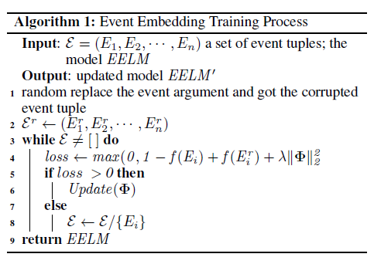
Neural Tensor Network for Learning Event Embeddings

Slide 7
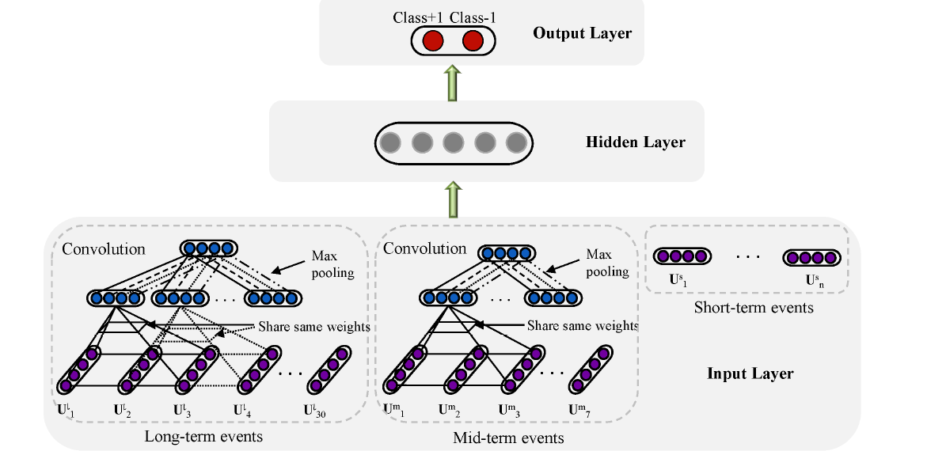




Deep prediction model
Notes:
Vs是Us的平均

Slide 8
Experiments
Experimental Settings
financial news from Reuters and Bloomberg over the period from October 2006 to November 2013
Standard & Poor’s 500 stock (S&P 500) index and its individual stocks
Evaluate index
Acc 2. Mcc
Baselines
The baselines are two state-of-the-art financial-news-based stock market prediction systems:
Luss and d’Aspremont et al（ bags-of-words， SVM）
Ding et al. （ structured event tuples ， standard feedforward neural network ）
WB-NN
WB-CNN
E-CNN
EB-NN
EB-CNN （this paper）
Notes:
标准普尔500指数，记录美国500家上市公司的一个股票指数，个股

Slide 9
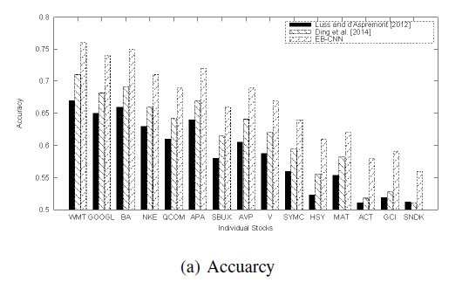
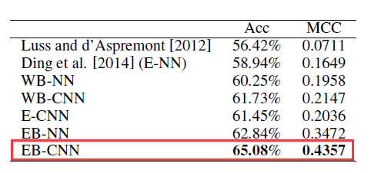
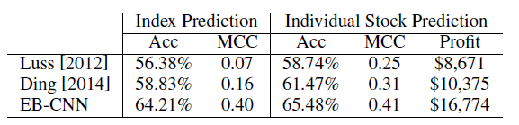
Experiments
Results

Slide 10
Experiments
Conclusions
events are better features than words for stock market prediction.
Event embedding is useful for the task of stock market prediction. This contrast demonstrates the importance of reducing sparsity, which rivals the effect of structured information.
CNN-based prediction models are more powerful than NN-based prediction models, which can extract the most representative feature vector for the prediction model.

Slide 11
Thanks

